Slide 1
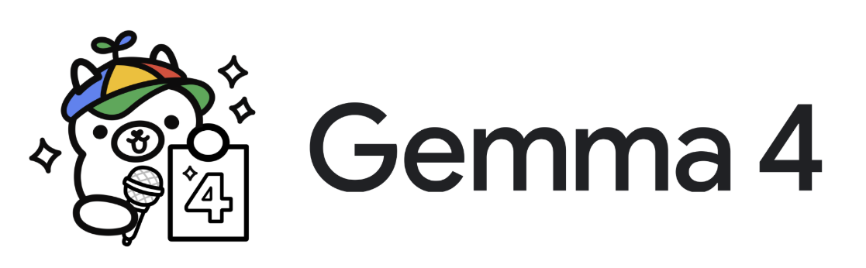
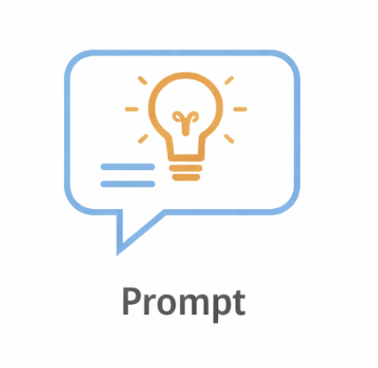
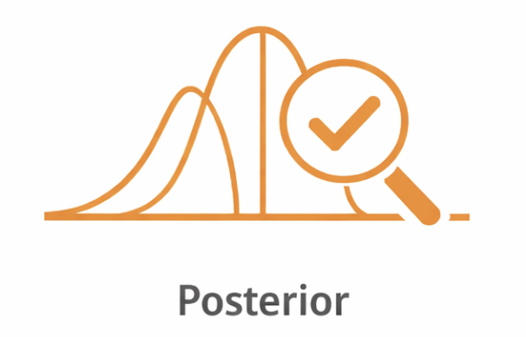

𝗙𝗿𝗼𝗺 𝗣𝗿𝗼𝗺𝗽𝘁𝘀 𝘁𝗼 𝗣𝗼𝘀𝘁𝗲𝗿𝗶𝗼𝗿𝘀: 𝗔𝗴𝗲𝗻𝘁𝗶𝗰 𝗕𝗮𝘆𝗲𝘀𝗶𝗮𝗻 𝗔/𝗕 𝗧𝗲𝘀𝘁𝗶𝗻𝗴 𝘄𝗶𝘁𝗵 𝗣𝘆𝗠𝗖
Sanjit Paliwal
Principal Data Scientist, Verizon
Image sources: ollama.com/library/gemma4, pymc.io and chatgpt prompt

Slide 2
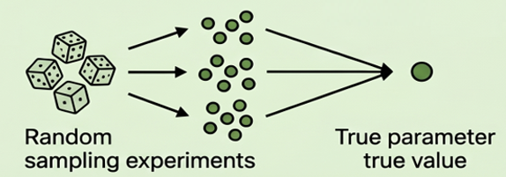
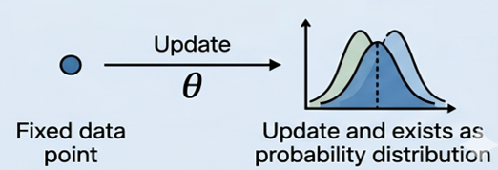
Frequentist vs Bayesian
Frequentist View
Bayesian View
Data: Random
Parameter : Fixed
Data: Fixed
Parameter: Random
Data Source: Fonnesbeck & Wiecki — Probabilistic Programming and Bayesian Computing with PyMC | PyData London 2024
Images source: Gemini prompt

Slide 3
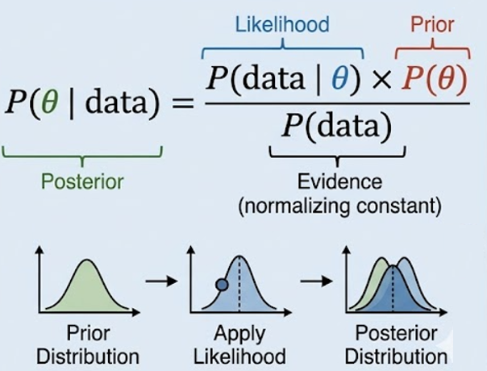
Ingredients of Bayesian Inference
Concepts
Bayes’ Theorem
Prior P(θ)
Belief about parameter before seeing data
Likelihood P(data| θ)
How likely the data is given the parameter
Posterior P (θ | data)
Updated belief after observing data
Data Source: Fonnesbeck & Wiecki — Probabilistic Programming and Bayesian Computing with PyMC | PyData London 2024
Image source: Gemini prompt

Slide 4
Bayesian A/B Testing
Experiment: Coffee shop tests two push notifications — which one gets more purchases?
A: "Your morning coffee is waiting"
B: " Get 10% off your coffee today!"
Prior: Start with a belief (Conversion rate is 5-10% or we have no idea)
Likelihood: Run experiment (A vs B) and collect data
Posterior: Update your belief (conversion rate) using data
Use MCMC sampling (PyMC) to estimate probability B is better and by how much (lift)
Frequentist | Bayesian
p-value + confidence interval | P(B > A) + credible interval (HDI)
Reject / don’t reject | 94% chance B is better
❌ Indirect, not decision-focused | ✅ Direct, intuitive, decision-ready
Decision: High probability + positive lift favors B

Slide 5

Agentic Bayesian A/B Testing
Inspired by Andrej Karpathy’s Autoresearch
LLM reads data, chooses a Bayesian model, and writes PyMC5 code
Script executes and runs MCMC via PyMC virtual env
Human writes the system prompt
No
LLM evaluates convergence
Human defines the experiment
Yes
Script saves the results
Image sources: ollama.com/library/gemma4 , pymc.io and chatgpt prompt

Slide 6
Results – Bayesian A/B Testing
A: “Your morning coffee is waiting”
Conversion Rate
Actual = 8.0%
Observed = 6.8%
B: “Get 10% off your coffee today!”
Conversion Rate
Actual = 13.0%
Observed = 13.4%
Lift
Actual = 62.5%
Observed = 97.1%
Weak Prior : Beta (1,1)
No prior knowledge
Lift = 99.6%
P (B >A) = 100.0%
Strong Prior: Beta(5,55)
Mean conversion rate – 8.3%
Lift = 89.0%
P (B >A) = 99.9%
Both Weak and Strong Priors Posterior MCMC chains converged

Slide 7
References
Fonnesbeck, C., & Wiecki, T. (n.d.). Probabilistic programming and Bayesian inference [Video]. YouTube. https://www.youtube.com/watch?v=99Rmi_CjqME
Google DeepMind. (2026). Gemma 4. https://deepmind.google/models/gemma/gemma-4/
Karpathy, A. (2026). AutoResearch: AI agents running research automatically [Computer software]. GitHub. https://github.com/karpathy/autoresearch
Ondrej, D. (2026). The only AutoResearch tutorial you’ll ever need [Video]. YouTube. https://www.youtube.com/watch?v=uBWuKh1nZ2Y
PyMC Development Team. (n.d.). Introduction to Bayesian A/B testing. PyMC Examples. https://www.pymc.io/projects/examples/en/latest/causal_inference/bayesian_ab_testing_introduction.html
Wikipedia contributors. (n.d.). Beta distribution. In Wikipedia, The Free Encyclopedia. Retrieved April 17, 2026, from https://en.wikipedia.org/wiki/Beta_distribution
Ollama. (n.d.). Gemma 4. https://ollama.com/library/gemma4
PyMC developers. (n.d.). PyMC: Probabilistic programming in Python. https://www.pymc.io/welcome.html

Slide 8
Thank You

